Slide 1
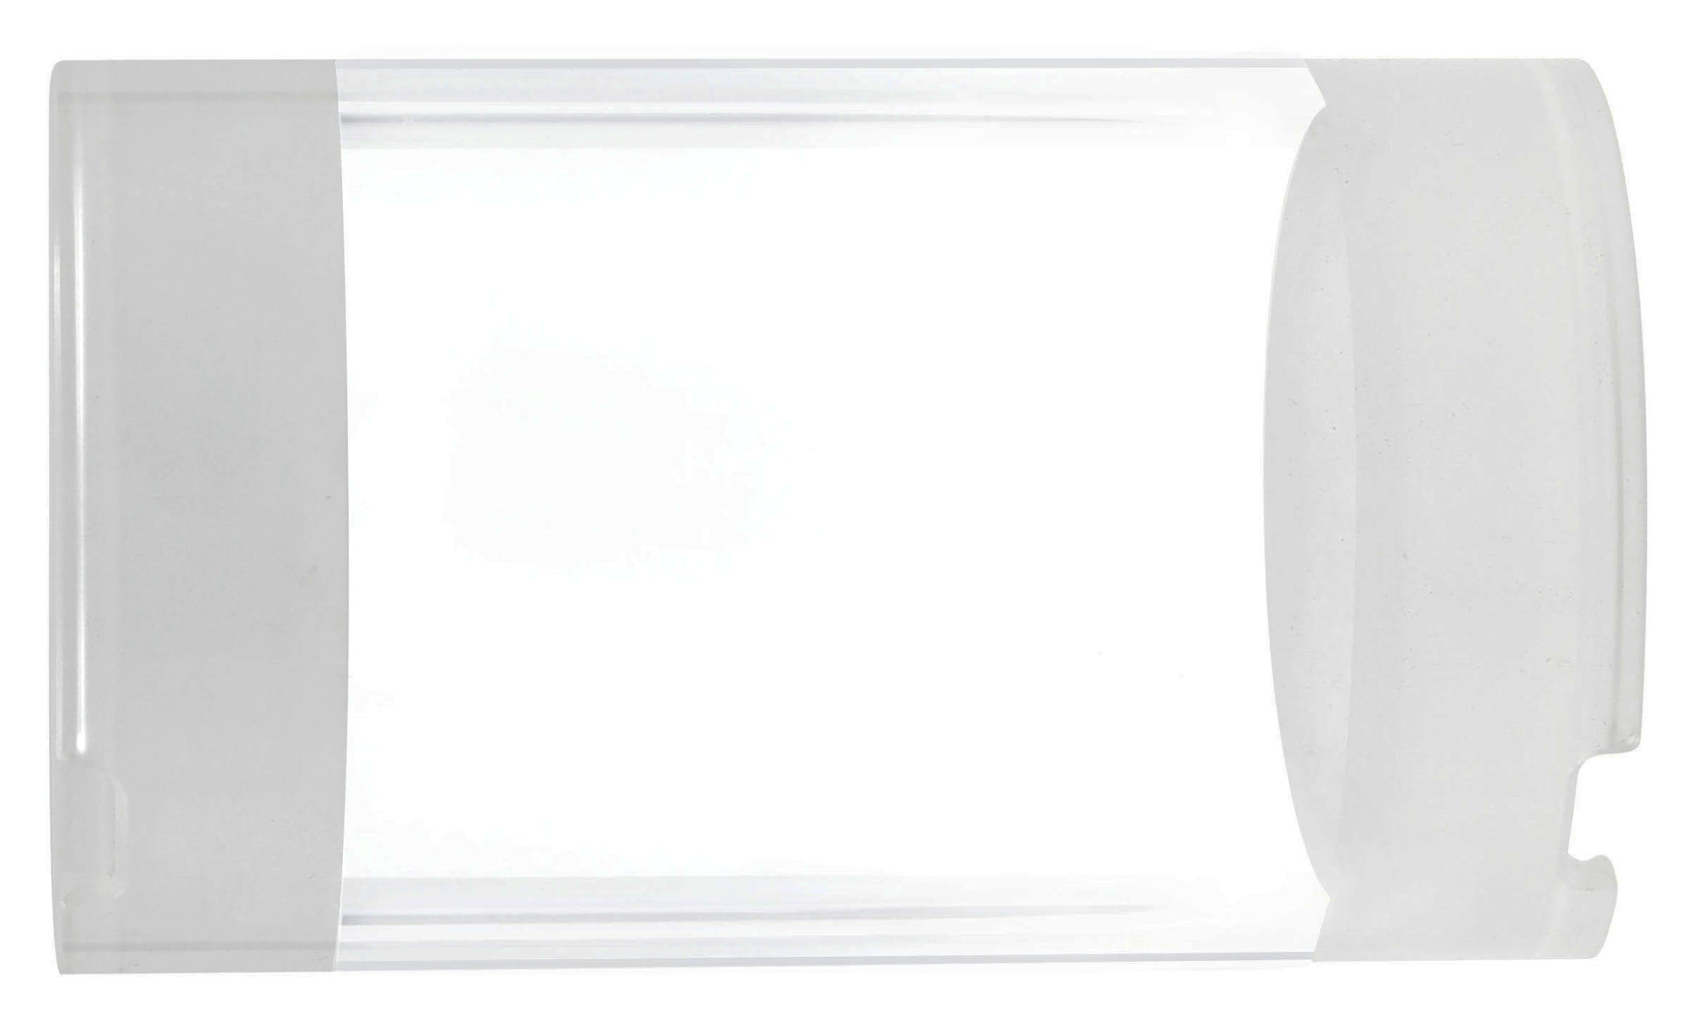
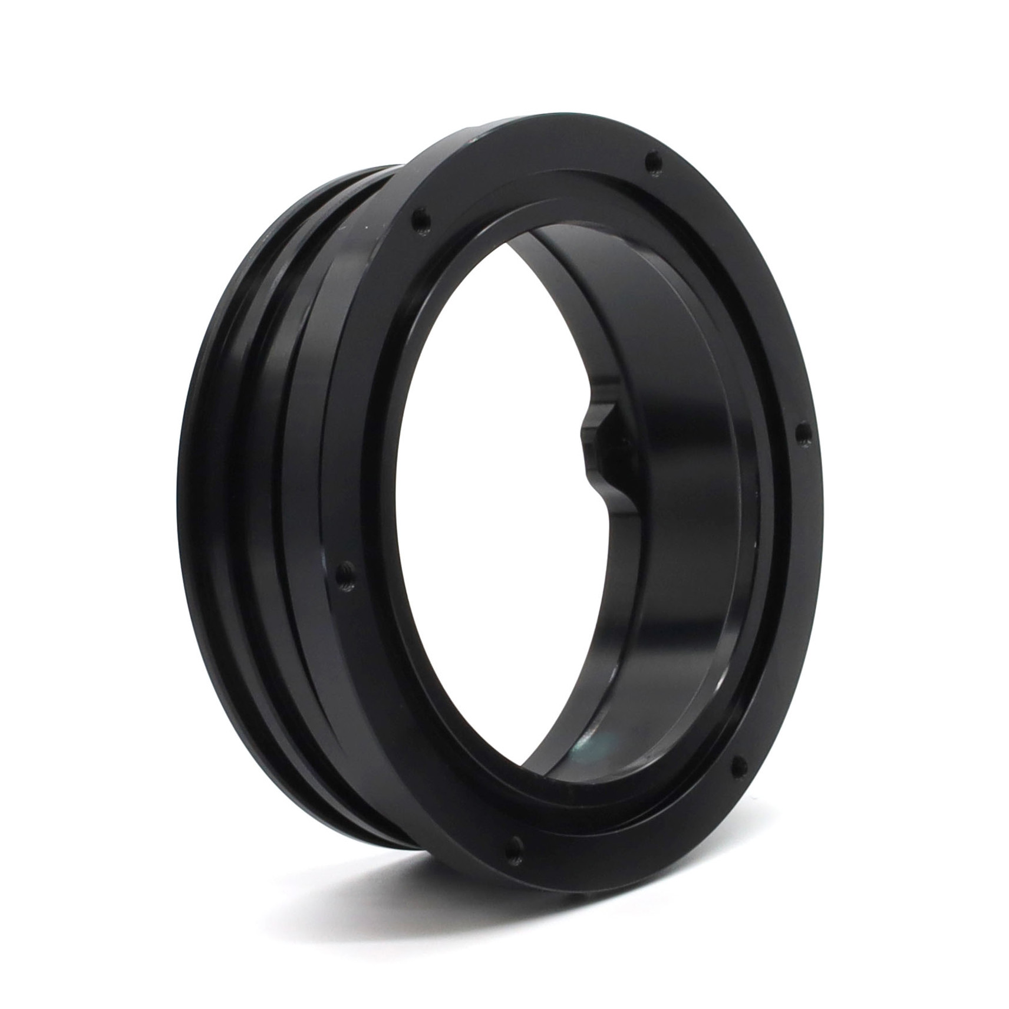
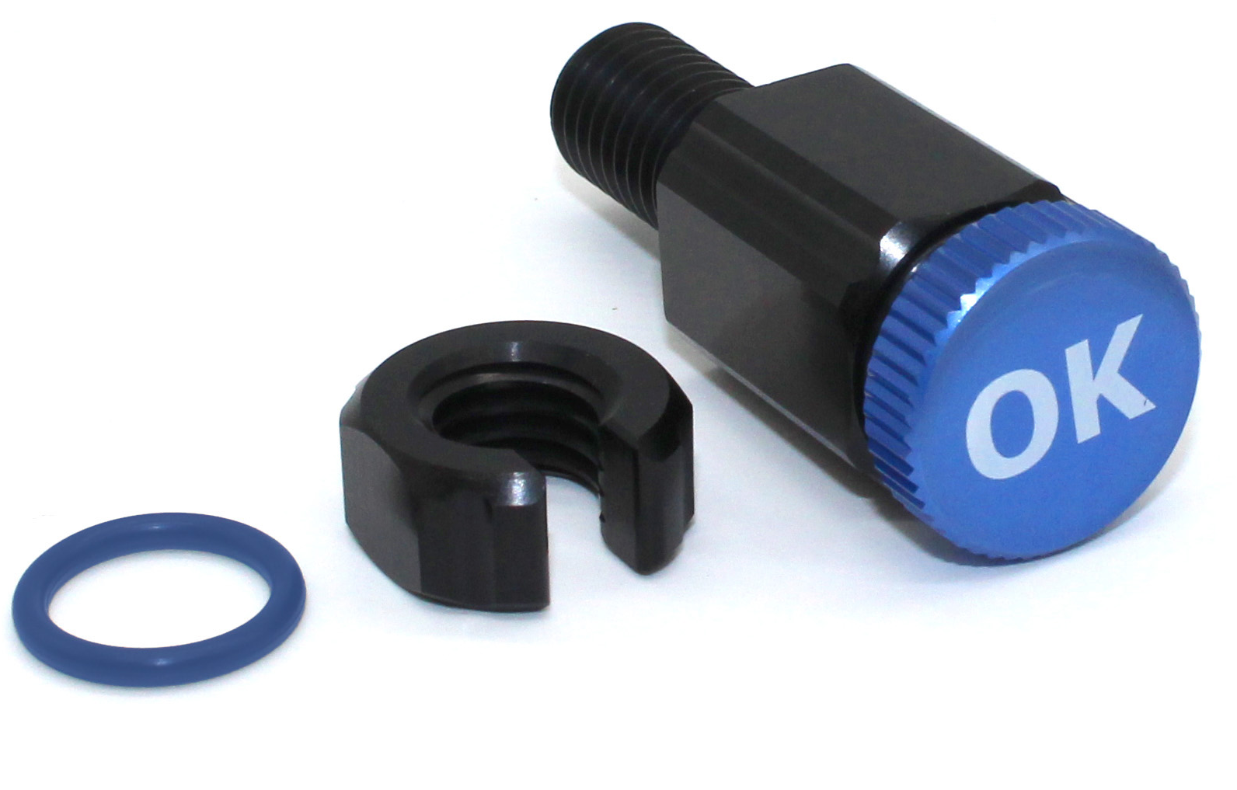
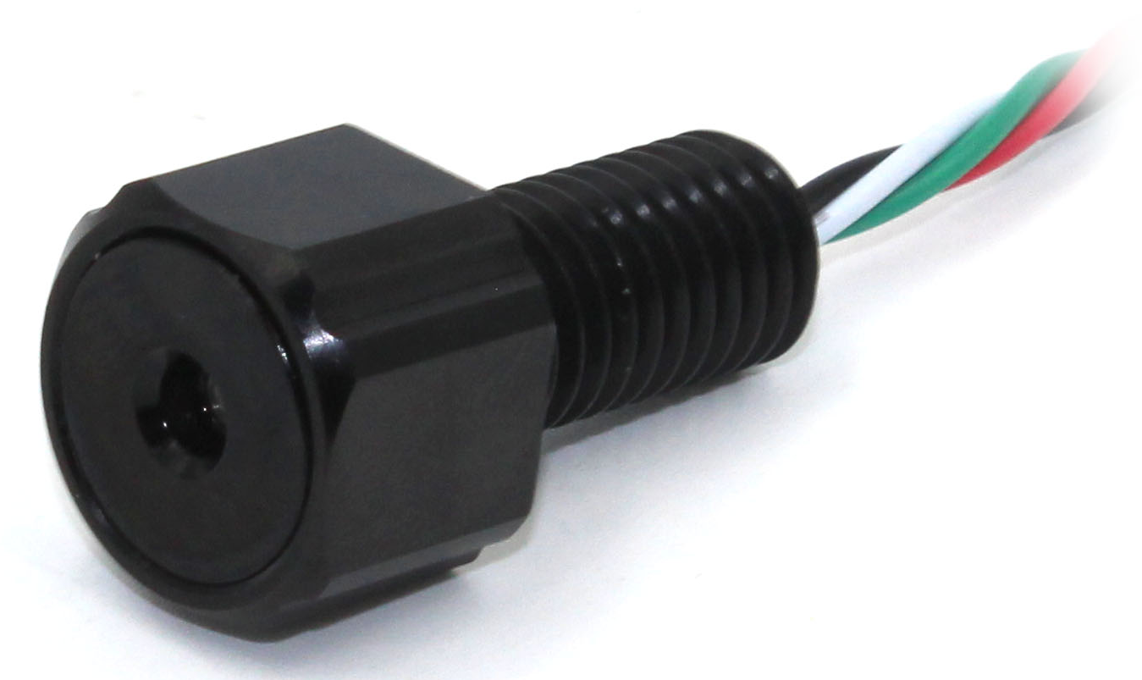
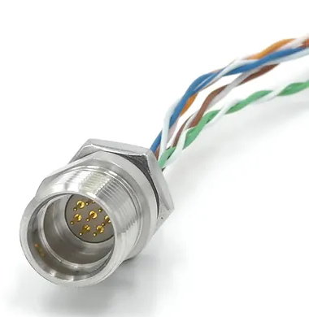
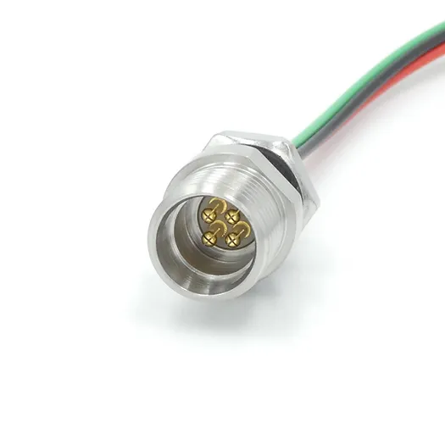
Enclosure tube
BR-102649-150
3’’ 15cm
Acrylic
End cap
BR-100949-007
3’’
7 Holes
Dome optically clear
3’’
BR-101059
Flange cap
BR-100647
3’’
Flange cap
BR-100647
3’’
x2
Dummy Plug
COB-1002
x2
Presse étoupe
8.5 mm HC
BR-100870-185
Locking sleeve
COB-1001
Caisson video 1
i
R
V_{r}=Ri
V_{GPIO}
V_{GPIO}-V_{f}
R =
V_{f}
i
7. Purge
1. Capteur TP
2. 8 pin
6. Cable
alimentation
3. Bouchon
5. Bouchon
4. 4 pin

